Slide 1
Computer Architecture
A Quantitative Approach, Sixth Edition
Chapter 1
Fundamentals of Quantitative Design and Analysis
Part 1: Overview
“I think it’s fair to say that personal computers have become the most empowering tool we’ve ever created. They’re tools of communication they’re tools of creativity, and they can be shaped by their user.” – Bill Gates, February 2004

Slide 2
Acknowledgements
Thanks to many sources for slide material
© 1990 Morgan Kaufmann Publishers, © 2001-present Elsevier
Computer Architecture: A Quantitative Approach by J. Hennessy & D. Patterson
© 1994 Morgan Kaufmann Publishers, © 2001-present Elsevier
Computer Organization and Design by D. Patterson & J. Hennessy
© 2002 K. Asinovic & Arvind, MIT
© 2002 J. Kubiatowicz, University of California at Berkeley
© 2006, © 2010 No Starch Press for Inside the Machine by J. Stokes
© 2007 W.-M. Hwu & D. Kirk, University of Illinois & NVIDIA
© 2007-2010 J. Owens, University of California at Davis
© 2010 CRC Press for Introduction to Concurrency in Programming Languages by M. Sottile, T. Mattson, and C. Rasmussen
© 2017, IBM POWER9 Processor Architecture by Sadasivam et al., IBM
© 2016, © 2019 POWER9 Processor User’s Manual, IBM
© The OpenPOWER Foundation

Slide 3
Computer Technology
Introduction
10 µm – 1971
6 µm – 1974
3 µm – 1977
1.5 µm – 1982
1 µm – 1985
800 nm – 1989
600 nm – 1994
350 nm – 1995
250 nm – 1997
180 nm – 1999
130 nm – 2001
90 nm – 2004
65 nm – 2006
45 nm – 2008
32 nm – 2010
22 nm – 2012
14 nm – 2014
10 nm – 2016–2017
7 nm – 2018–2019
5 nm – 2020–2021
Performance Improvements
Improvements in semiconductor technology
Feature size and clock speed
Improvements in computer architectures
Enabled by HLL compilers and UNIX
RISC (Reduced Instruction Set Architecture)
Invented by John Cocke @ IBM (early 1970s)
Resulted in general-purpose IBM 801
Led to the RISC architectural revolution in 1980s (Patterson & Hennessy)
End Result
Lightweight computers
Productivity-based managed/interpreted
programming languages
Notes:
The size of the elements on a chip, which is designated by the "DRAM half pitch." The smallest feature size is generally smaller than the feature size for a technology generation (technology node). For example, the 180 nm technology generation will have gate lengths smaller than 180 nm.
The common measure of the technology generation of a chip. It is half the distance between cells in a dynamic RAM memory chip.
In 1974, IBM began examining the possibility of constructing a telephone switch to handle a 300 calls per second. They calculated that each call would require 20,000 instructions to complete, and when one added timing overhead and other considerations, such a machine would required performance of about 12 MIPS.^{[1]} This would require a significant advance in performance; their current top-of-the-line machine, the IBM System/370 Model 168 of late 1972, offered about 3 MIPS.^{[2]}
The group working on this project at the Thomas J. Watson Research Center, including John Cocke, designed a processor for this purpose. To reach the required performance, they considered the sort of operations such a machine required and removed any that were not appropriate. This led to the removal of a floating-point unit for instance, which would not be needed in this application. More critically, they also removed many of the instructions that worked on data in main memory and left only those instructions that worked on the internal processor registers, as these were much faster to use (effectively zero-time) and the simple code in a telephone switch could be written to use only these types instructions. The result of this work was a conceptual design for a simplified processor with the required performance.^{[1]}
The telephone switch project was canceled in 1975, but the team had made considerable progress on the concept and in October IBM decided to continue it as a general-purpose design.

Slide 4
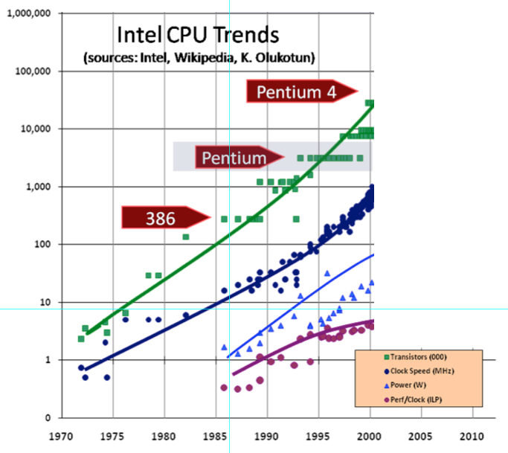
Introduction
Notes:
This would be good to replace with IBM CPU trends.
3:15
-By mid-2000s, we could no longer scale clock rates at same rate.
-As shown here, e.g., dual-core CPUs in 2006 with flattened out clock speeds, power, and perf/clock.
H. Sutter, “The Free Lunch Is Over: A Fundamental Turn Toward Concurrency in Software,” Dr. Dobb’s Journal, 30(3), March 2005. (Updated August 2009.)

Slide 5
How to Improve Performance
Improving Performance
Serial Code Stream
Parallel Code Streams
Parallelize Serial Code Stream
Identify and Isolate Parallel Tasks
time
Increase instructions per clock cycle.
Increase throughput or work completed per unit time.
Lower latencies intrinsic in the system that limit the above metrics.
Notes:
Superscalar

Slide 6
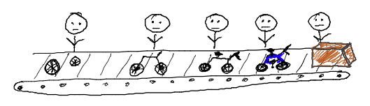
How To Increase Instructions Per Clock Cycle?
Pipelining
Breakdown complex instructions into a set of smaller steps that are executed in order like a factory assembly line.
Improving Performance
Source: Matthew Sottile

Slide 7
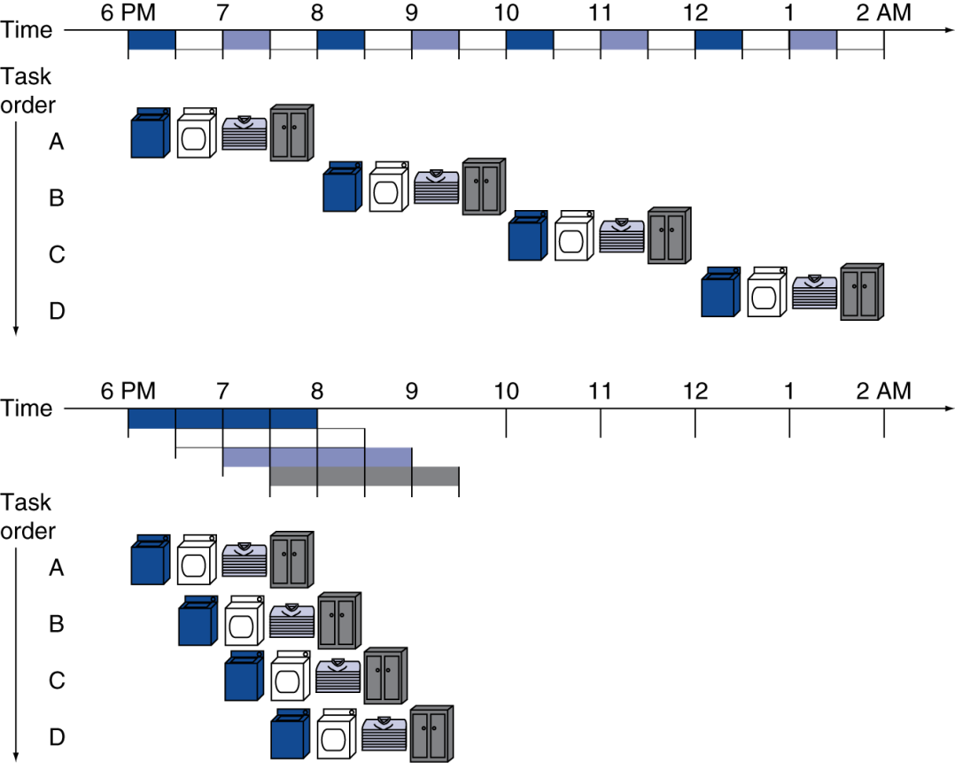
Pipelining: Analogy
Pipelining laundry overlaps execution
Parallelism improves performance
Improving Performance
One load = 2 hours
Four loads:
serial throughput:
0.5 load/hour
pipelined throughput:
1.14 load/hour
speedup:
8 / 3.5 ≈ 2.3
Non-stop speedup:
2n / (0.5n + 1.5) ≈ 4

Slide 8
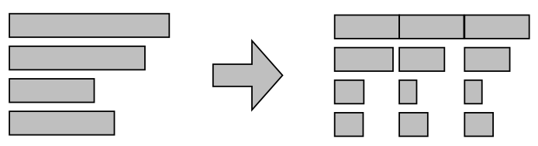
Pipelining: Evolution
Increase # of steps, thus decreasing complexity of each step and allowing each step to complete faster.
Fine-grained steps reduce the difference between times in each stage for instructions of differing complexity.
If all instructions use the same pipeline, each instruction takes effectively the same amount of time to complete.
Improving Performance
instruction
stage1
stage2
stage3

Slide 9
Pipelining in Practice
PROGRAM
instr A
instr B
instr C
instr D
instr E
instr F
:
instr W
instr X
instr Y
branch instruction
A fully saturated pipeline can ideally yield one completed instruction per cycle.
As pipelines get deeper and deeper, more important than ever to avoid bubbles or pipeline ﬂushes that result in an increase in average cycles per instruction.
Improving Performance
time
Branch taken.
Flush the pipeline.
IF_{A} | ID_{A} | EX_{A} | MEM_{A} | WB_{A}
 | IF_{B} | ID_{B} | EX_{B}
 |  | IF_{C} | ID_{C}
 |  |  | IF_{D}
 |  |  |  | IF_{x} | ID_{x} | EX_{x} | MEM_{x} | WB_{x}
 |  |  |  |  | IF_{y} | ID_{y} | EX_{y} | MEM_{y} | WB_{y}
program
flow

Slide 10
Pipelining Requires ILP
Why does pipelining work?
Instruction-level parallelism (ILP)
Non-trivial portions of program code are composed of sequences of instructions that can be reordered and executed in parallel without impacting the output of the program.
The pipeline allows multiple instructions to be “in-ﬂight” at any given time.
Improving Performance
mov ax, 4
mov bx, 5
add cx, ex, ex
mul dx, ex, ex
bne cx, dx, label

Slide 11
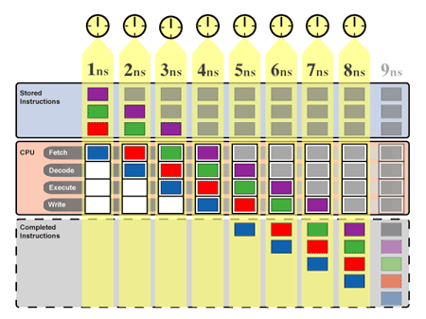
The MHz Race …
Improving Performance
Industry got away with
increases in pipeline depth
and related hardware
complexity (see Intel CPU
Trends slide) to ramp-up
processor clock speeds.
“Houston … we have a problem …”
Power and cooling are design constraints of equal importance to performance now.
Cooling: amount of cooling necessary, type of cooling, packaging.
Power: battery requirements, electric bills.

Slide 12
Power Density
Projection:
Rocket Nozzle
1000
Improving Performance
Chip Maximum
Power in watts/cm²
Not too long to reach
Nuclear Reactor
Itanium – 130 watts
100
Pentium 4 – 75 watts
Surpassed
Heating Plate
Pentium III – 35 watts
Pentium II – 35 watts
Pentium Pro – 30 watts
10
Pentium – 14 watts
I486 – 2 watts
I386 – 1 watt
1
1.5μ
1μ
0.7μ
0.5μ
0.35μ
0.25μ
0.18μ
0.13μ
0.1μ
0.07μ
1985
1995
2001
Year
Source: Fred Pollack, Intel. New Microprocessor Challenges in the Coming Generations of CMOS Technologies, MICRO32 and Transmeta
Notes:
Would be good to have IBM power density plotted (separately).

Slide 13
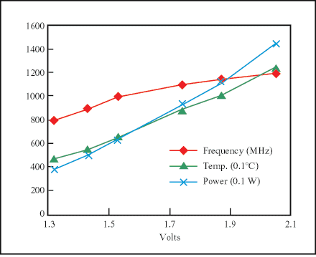
Power
Improving Performance
Power is really a function of …
Die size
More transistors and wires to feed
Frequency f
How often do you need to feed them
Voltage V
At what level do you need to feed them
Pipelining: A double-edged sword
Better Performance (Maybe) and Higher Power Consumption
Increase # of small steps to realize an instruction. More small steps = deeper pipeline = higher f and V, thus enabling better performance but …
Better performance only if pipeline can be kept full. Difficult to do as pipelines get deeper.

Slide 14
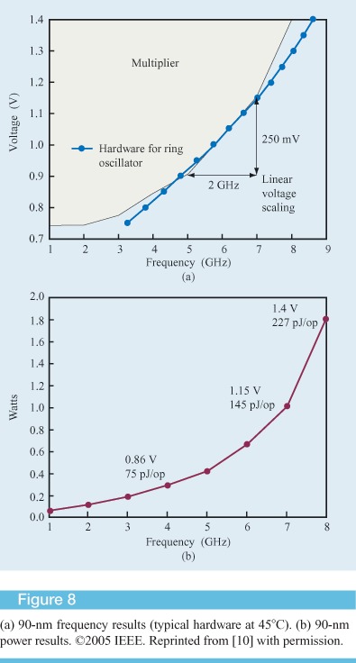
Frequency, Voltage, and Power
Improving Performance

Slide 15
Solutions to Power & Cooling
Reduce component count (transistors and wires)
Reduce complexity, e.g., ARM and Transmeta CPUs
Shrink components
Moore’s Law: An observation that the number of transistors on a chip doubles every year while costs are halved.
Caveat: The End of Moore’s Law?
2019: Intel @ 10nm. AMD & Apple @ 7nm.
Further shrinking has gotten more complicated.
No transistor shrink from Intel between 2014-2019.
Reduce leakage of transistors
Manage power intelligently via software
Example: C. Hsu & W. Feng, “A Power-Aware Run-Time System for High-Performance Computing,” ACM/IEEE SC 2005, November 2005.
Improving Performance
Notes:
Due to a “defect mode” in their 7nm process, Intel 7nm isn’t slated to come out until 2023 now!

Slide 16
Recall: Pipelining Requires ILP
Why does pipelining work?
Instruction-level parallelism (ILP)
Non-trivial portions of program code are composed of sequences of instructions that can be reordered and executed in parallel without impacting the output of the program.
The pipeline allows multiple instructions to be “in-ﬂight” at any given time.
Improving Performance
mov ax, 4
mov bx, 5
add cx, ex, ex
mul dx, ex, ex
bne cx, dx, label

Slide 17
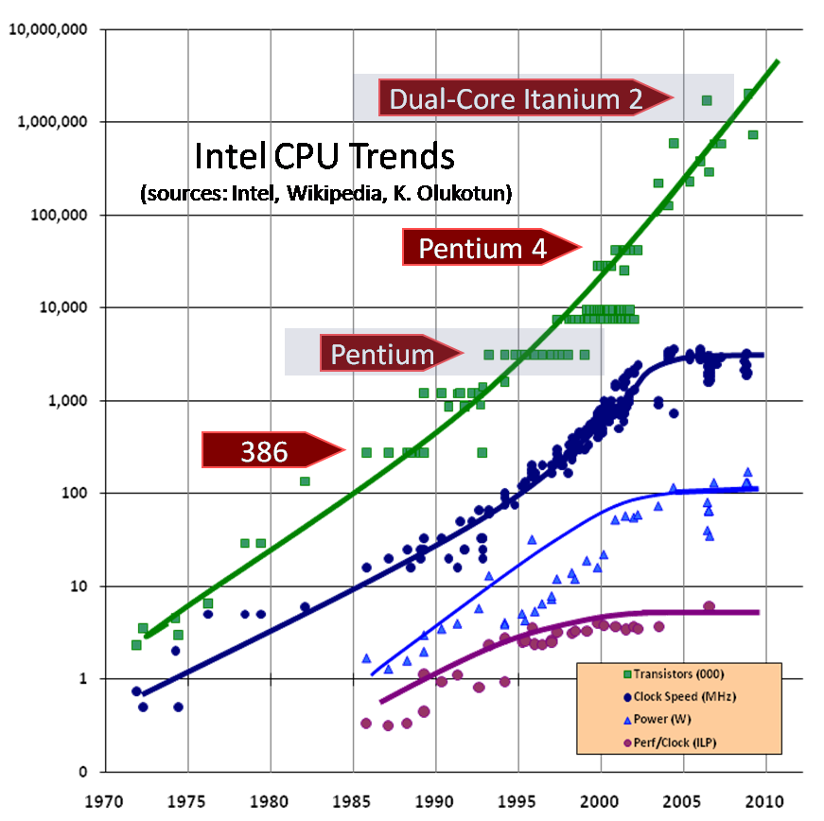
Trends
ILP
Notes:
This would be good to replace with IBM CPU trends.
-By mid-2000s, we could no longer scale clock rates at same rate.
-As shown here, e.g., dual-core CPUs in 2006 with flattened out clock speeds, power, and perf/clock.
H. Sutter, “The Free Lunch Is Over: A Fundamental Turn Toward Concurrency in Software,” Dr. Dobb’s Journal, 30(3), March 2005. (Updated August 2009.)

Slide 18
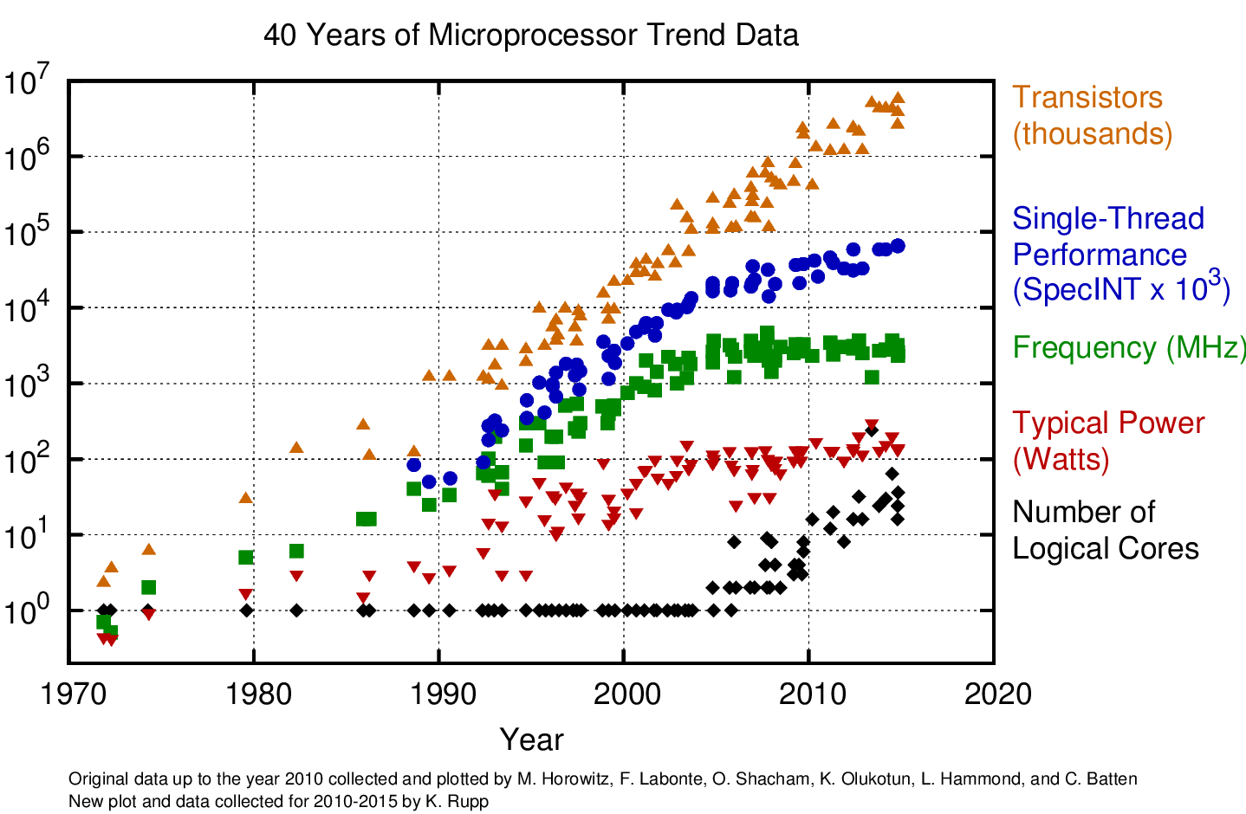
Trends
https://www.karlrupp.net/wp-content/uploads/2015/06/40-years-processor-trend.png

Slide 19
Key to Performance: ILP?
Trends
Smaller steps = deeper pipeline = more ILP = higher f
but …
Hardware much more complex
Hardware runs hotter
Deeper pipelines and better ILP identification has gotten harder and more costly → diminishing returns
Solution? Other forms of parallelism
Data-level parallelism (DLP)
Vector architectures and graphics processing units (GPUs)
Thread-level parallelism (TLP)
Multicore
Request-level parallelism (RLP)
A change in technology direction that forces a fundamental rethinking of how to continue boosting performance.

Slide 20
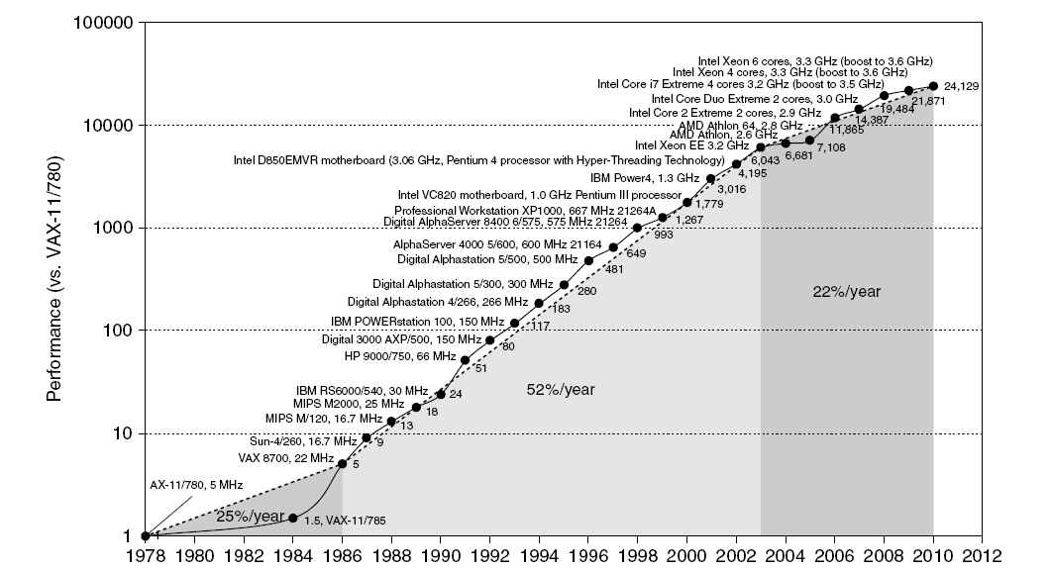
Single-Processor Performance
Trends
Commodity multi-core
Multi-core
Commodity RISC

Slide 21
Current Trends in Architecture
Trends
Cannot continue to rely only on instruction-level parallelism (ILP)
Single-processor performance improvement ended in 2003
The “power wall” is rearing its ugly head
New models for performance
Data-level parallelism (DLP)
Vector architectures and graphics processing units (GPUs)
Thread-level parallelism (TLP)
Multicore
Request-level parallelism (RLP)
Consequence
Explicit restructuring of an application

Slide 22
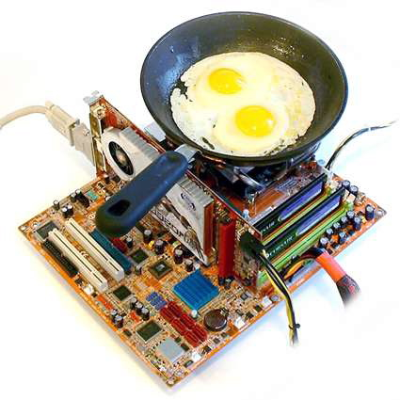
Why Multicore?
Defining Computer Architecture
The MHz race ran out of steam
The “free ride” is over
Trade-off between raw performance and practical physical implementation and utilization.
Power consumption an increasingly “hot” issue
… enough to nearly fry an egg.
Result
Virtually impossible to buy a non-multicore processor in any computer now.

Slide 23
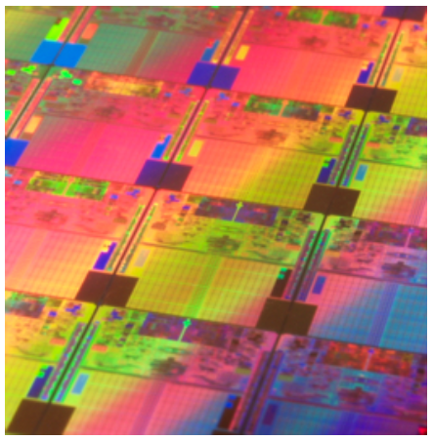
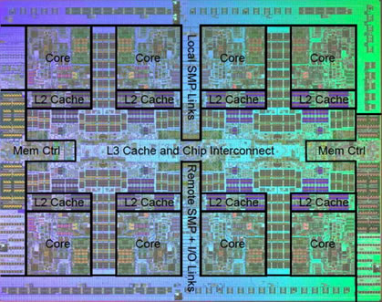
What is Multicore?
A multicore chip is a single silicon die containing multiple fully functional sequential processor cores tied together to form a small parallel computer.
Defining Computer Architecture
Source: Intel Corporation
Source: IBM
Notes:
Left. This would be good to replace or supplement with a multicore POWER architecture.
Right. Would prefer a simpler POWER architecture for pedagogical purposes, e.g., POWER4. Showing IBM POWER 7.

Slide 24
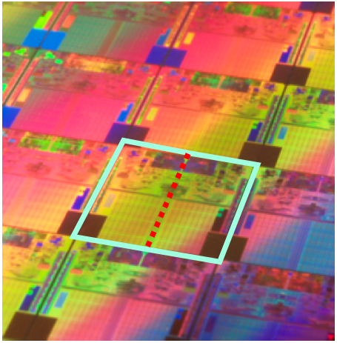
A Closer Look at Multicore
Multicore Highlighted
Intel Core 2 processor on a larger silicon wafer.
Anatomy
Two cores of Intel Core 2 processor separated by a red line.
Cache is the very regular portion. Light colored.
Functional units are up above. Dark colored.
Defining Computer Architecture
Notes:
This would be good to replace with a multicore POWER architecture.
Q: Articulate which subsystem on a processor die consumes the most real estate.
A: Cache memory

Slide 25
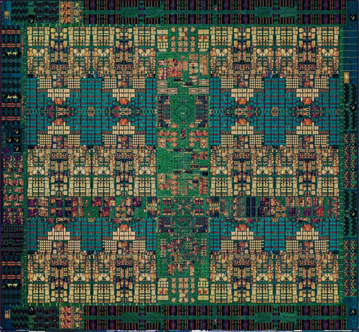
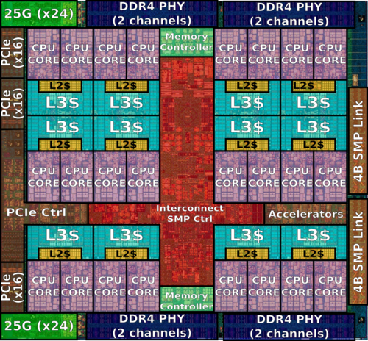
A Closer Look at Multicore
IBM Power7
IBM Power9
Defining Computer Architecture
Notes:
Q: Which subsystem on a processor die consumes the most real estate?
A: Cache memory and associated memory controllers and interfaces.

Slide 26
Multicore: Solution to Power & Performance
Multicore Recipe
Stop increasing the complexity of single cores.
Replicate simpler cores on a die and exploit thread-level parallelism (TLP).
Reduce clock rates as pipelines do not have to be so deep, thus reducing power requirements.
Hyperthreading NOT?!
Many units in the CPU are shared between the “virtual cores” that hyperthreading provides, limiting performance seen in practice.
Hyperthreaded processor (i.e., two-way simultaneous multithreading) still suffers from the complexity problem, leading to higher power and cooling requirements.
Defining Computer Architecture

Slide 27
Don’t Be Misled!
Pipelining is here to stay.
At a certain granularity, blocks of instructions in typical programs exhibit a good degree of ILP.
New CPUs still improve pipelining and related single-threaded performance improvements.
… but it’s not the focus anymore.
Defining Computer Architecture
Notes:
Hierarchical parallelism! ILP, DLP (below), TLP (above), inter-TLP/request-level parallelism

Slide 28
Trends
ILP
Notes:
This would be good to replace with IBM CPU trends.
-By mid-2000s, we could no longer scale clock rates at same rate.
-As shown here, e.g., dual-core CPUs in 2006 with flattened out clock speeds, power, and perf/clock.
H. Sutter, “The Free Lunch Is Over: A Fundamental Turn Toward Concurrency in Software,” Dr. Dobb’s Journal, 30(3), March 2005. (Updated August 2009.)

Slide 29
Trends
https://www.karlrupp.net/wp-content/uploads/2015/06/40-years-processor-trend.png

Slide 30
Defining Computer Architecture
“Old” View of Computer Architecture:
Instruction set architecture (ISA) design
Decisions regarding
registers, memory addressing, addressing modes, instruction operands, available operations, control flow instructions, instruction encoding
“Real” Computer Architecture
Specific requirements of the target machine
Design to maximize performance within constraints: cost, power, and availability
Includes ISA, microarchitecture, hardware
Defining Computer Architecture
Notes:
As we move from one process to the next (e.g., 32nm → 22nm → 14 nm,
Increase in # of transistors switching & frequency with which they switch dominate …
… the decrease in load capacitance and voltage, leading to an overall growth in power consumption and energy.

Slide 31
Power and Energy
Trends
Problem: Get power in, get power out
Thermal Design Power (TDP)
Characterizes sustained power consumption
Used as target for power supply and cooling system
Lower than peak power, higher than average power consumption
Clock rate can be reduced dynamically to limit power consumption
P α CV²f, where C is capacitance being switched per clock cycle, V is supply voltage of processor, and f is switching frequency
Energy per task is often a better measurement

Slide 32
Dynamic Energy and Power
Trends
Dynamic energy
Transistor switch from 0 → 1 or 1 → 0
½ x capacitive load x voltage²
Dynamic power
½ x capacitive load x voltage² x frequency switched
Reducing clock rate reduces power, not energy

Slide 33
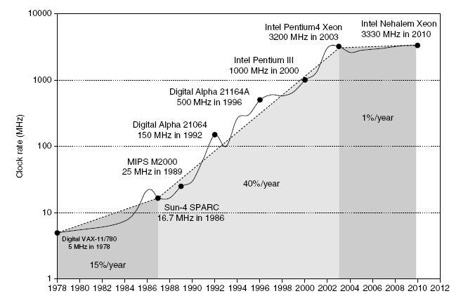
Power
Trends
Intel 80386 ~ 2 W
3.3-GHz Intel Core i7 ~ 130 W
Heat must be dissipated from 1.5 x 1.5 cm chip
This is the limit of what can be cooled by air
Notes:
This would be good to have some IBM numbers, too.
Given the P = CV^2f equation, expect clock frequency growth to slow down if we cannot reduce voltage or increase power per chip.
Distributing the power, removing the heat, and preventing hot spots have become increasingly difficult challenges.
Now: Power is the major constraint to using transistors.
Past: Raw silicon area.

Slide 34

Reducing Power
Trends
Techniques for Reducing Dynamic Power
Do nothing well
Dynamic voltage-frequency scaling (2005)
C. Hsu and W. Feng, “A Power-Aware Run-Time System for High-Performance Computing,” ACM/IEEE SC, Nov. 2005.
Low-power state for DRAM and disks
Overclocking and turning off cores
Intel Turbo mode (2008)
Power capping via RAPL (2012-2013)
A technique available on Intel processors
B. Subramaniam and W. Feng, “Towards Energy-
Proportional Computing for Enterprise Server
Workloads,” In 3rd ACM/SPEC International
Conference on Performance Engineering (ICPE),
Best Paper Award, April 2013.
Notes:
This would be good to replace with mechanisms for the POWER architecture.
Do nothing well
Turn off the clock for inactive modules to save energy and dynamic power, e.g., no floating-point operations executing, disable clock of floating-point unit. (Is this reasonable? Depends on application.
DVFS

Slide 35
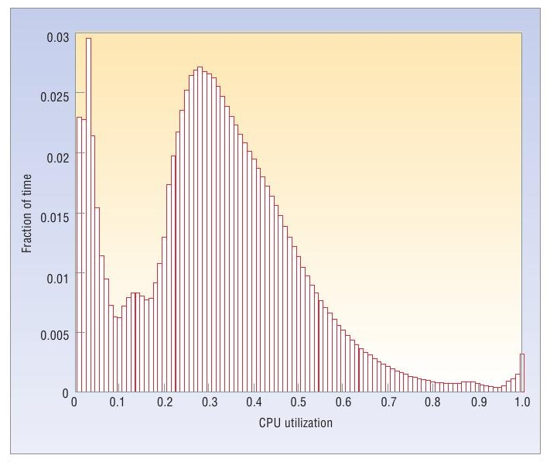
Severe Underutilization in Data Centers
Trends
Average CPU utilization of 5000 servers over a six-month period
Source: L. A. Barroso et al., The Case for Energy-Proportional Computing, IEEE Computer, 2007
Notes:
… but data centers are under-utilized.
… clusters in data centers are heavily under-utilized. (Don’t think you need to refer to clusters for this audience.)
Region of data center operation: 20%-50%.

Slide 36
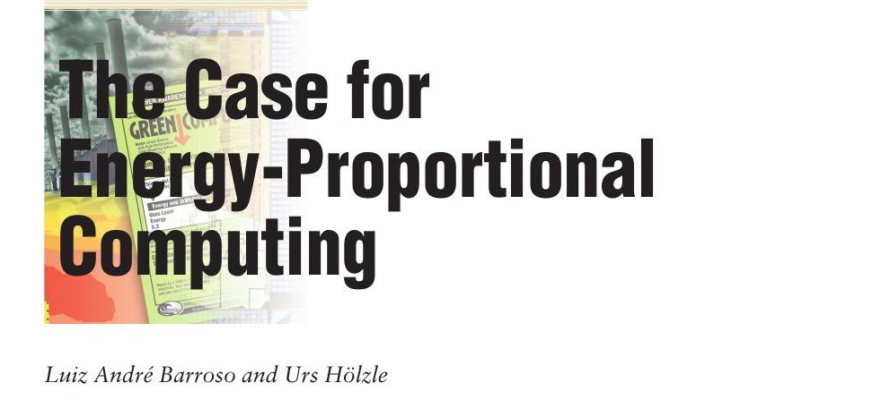
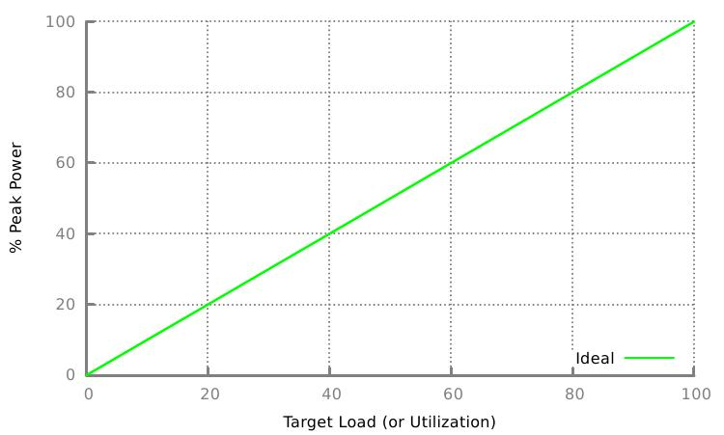
Trends
Consume power proportional to utilization (or load level)
Notes:
Energy-proportional operation on line.
Better below
Worse above

Slide 37
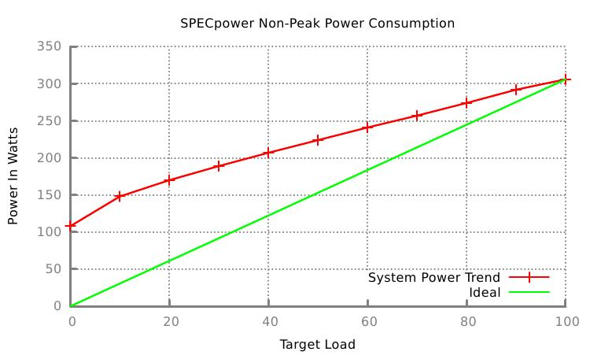
Power Efficiency at Different Levels of Utilization
Trends
Near energy-proportional power consumption at high levels of utilization
B. Subramaniam and W. Feng, “Towards Energy-Proportional Computing for Enterprise Server Workloads,” In 3rd ACM/SPEC International Conference on Performance Engineering (ICPE), April 2013.

Slide 38
Static Power
Trends
Static power consumption
Current_{static} x Voltage
Scales with number of transistors
How to reduce? Power gating

Slide 39
Bandwidth and Latency
Trends
Bandwidth or throughput
Total work done in a given time
10,000-25,000x improvement for processors
300-1200x improvement for memory and disks
Latency or response time
Time between start and completion of an event
30-80x improvement for processors
6-8x improvement for memory and disks

Slide 40
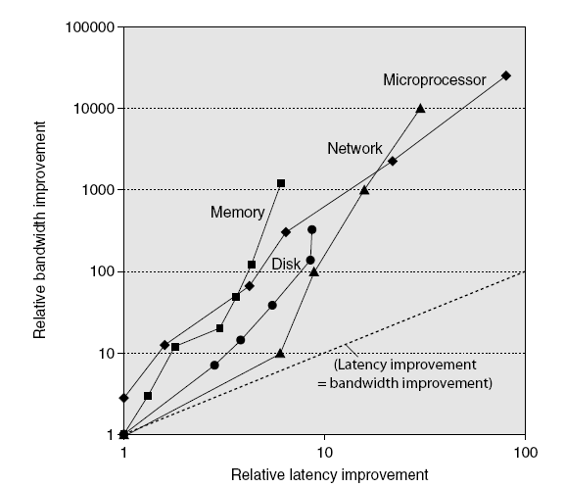
Bandwidth and Latency
Trends
Log-log plot of bandwidth and latency milestones

Slide 41
Transistors and Wires
Trends
Feature Size
Minimum size of transistor or wire in x or y dimension
40 years of shrinking
10 microns in 1971 to 0.032 microns (32 nm) in 2011
Further shrinking slowing & getting more complicated
No transistor shrink from Intel 2014-2019! @ 14nm.
2019: Intel @ 10nm while AMD & Apple @ 7nm.
2020: IBM @ 7nm for POWER10 → DOE supercomputers: Sierra (LLNL) and Summit (ORNL)
Transistor performance scales linearly
Wire delay does not improve with feature size
Integration density scales quadratically
10 µm – 1971
6 µm – 1974
3 µm – 1977
1.5 µm – 1982
1 µm – 1985
800 nm – 1989
600 nm – 1994
350 nm – 1995
250 nm – 1997
180 nm – 1999
130 nm – 2001
90 nm – 2004
65 nm – 2006
45 nm – 2008
32 nm – 2010
22 nm – 2012
14 nm – 2014
10 nm – 2016–2017
7 nm – 2018–2019
5 nm – 2020–2021
Notes:
The feature size of any semiconductor technology is defined as the minimum length of the MOS transistor channel between the drain and the source.
180nm -->> 130nm -->> 90nm -->> 65nm -->> 40nm -->> 28nm --> 22nm... (Where do these #s come from? Arbitrary?)
In early 1970s, Gordon Moore of Intel predicted that the number of transistor on a an integrated circuit would double itself in approximately 18-24 months. This prediction has proven to be accurate as scaling of technology continues unabated even after 40 years! Why?
If double the # of transistors can be incorporated on the same area, it means we get double (roughly) functionality for the same cost!
Alternatively, with scaling of technology, the same functionality will be available at roughly half the cost!
Moreover, smaller the channel length, faster would be the transient response of the transistors which would translate into better performance!
The goal of every design company now is to double the number of transistors on their integrated circuits with each technology. As you would notice, the numbers above from 180nm to 130nm to 90nm scale down by roughly a factor of 0.7. What's so special about 0.7?
If the feature size of the transistor is scaled by 0.7, the area would be scaled by a factor of 0.7²=0.49 =~ 0.5. That means if we scale our feature sizes by a factor of roughly 0.7, we would be able to pack twice the number of transistors on the same area as the previous technology!
IBM: 32 nm high-κ metal gate process.

Slide 42
Case Study for Transistors & Wires: IBM POWER
Feature | POWER7+ | POWER8 | POWER9 | POWER10
Year | 2012 | 2014 | 2017 | 2020
Terminology | 32 nm | 22 nm | 14 nm | 7 nm
Die Size | 567 mm² | 649 mm² | 693 mm² | 602 mm²
# Transistors | 2.1B | 4.2B | 8.0B | 18.0B
Max. Cores | 8 | 12 | 12 / 24 | 15 / 30
Max. SMT Threads/Core | 4 | 8 | 8 / 4 | 8 / 4
Max. Threads | 32 | 96 | 96 | 120
Max. Frequency | 4.0 GHz | 4.15 GHz | 4.4 GHz | 4.0 GHz
L2 Cache | 256 kB / core | 512 kB / core | 512 kB shared | 512 kB / core
L3 Cache | 80 MB | 96 MB | 120 MB | 120 MB
Memory Support | DDR3 | DDR3, DDR4 | DDR4 | DDR3-DDR5, GDDR6, HBM
I/O Bus | GC++ | PCIe Gen3 | PCIe Gen4 | PCIe Gen5
Notes:
POWER10 includes PCIe 5. The SCM has 32x and the DCM has 64x PCIe 5 lanes. IBM and Nvidia agreed that including NVLink in POWER10 would be redundant since PCIe 5 is fast enough for attaching GPUs so NVLink is not present.^{[3]} Support for NVLink on-chip was previously a unique selling point for POWER8 and POWER9.

Slide 43
Trends in Cost
Trends
Cost driven down by learning curve
Yield
DRAM: price closely tracks cost
Microprocessors: price depends on volume
10% less for each doubling of volume

Slide 44
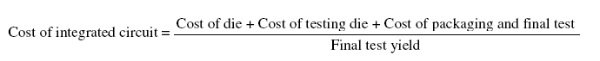
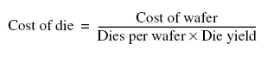
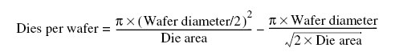
Integrated Circuit Cost
Trends
Integrated Circuit
Bose-Einstein formula:
Defects per unit area = 0.016-0.057 defects per cm² (2010)
N = process-complexity factor = 11.5-15.5 (40 nm, 2010)
Notes:
Costs of IC have dropped exponentially but basic process of silicon manufacturing unchanged.
Wafer still tested and chopped into dies
Learning how to predict # of good chips per wafer requires learning how many dies fit on a wafer and how to predict the % of those that will work.
Dies per wafer is sensitive to die size.
First term is ratio of wafer area TO die area.
Second term is for the “square peg in the round hole” problem. Rectangular dies near the periphery of round wafers (divide circumference by diagonal of square die).

Slide 45
Dependability
Trends
Module Reliability
Mean time to failure (MTTF)
Mean time to repair (MTTR)
Mean time between failures (MTBF) = MTTF + MTTR
Availability = MTTF / MTBF
Notes:
Availability = MTTF / MTBF = MTTF / (MTTF + MTTR)

Slide 46
Recall: Defining Computer Architecture
“Old” View of Computer Architecture:
Instruction set architecture (ISA) design
Decisions regarding
registers, memory addressing, addressing modes, instruction operands, available operations, control flow instructions, instruction encoding
“Real” Computer Architecture
Specific requirements of the target machine
Design to maximize performance within constraints: cost, power, and availability
Includes ISA, microarchitecture, hardware
Defining Computer Architecture

Slide 47
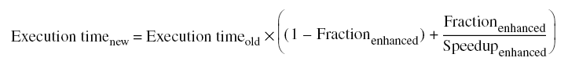
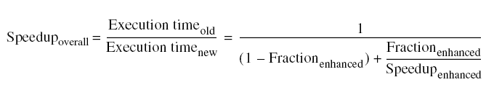
Principles of Computer Design
Principles
Take Advantage of Parallelism
e.g., multiple processors, disks, memory banks, pipelining, multiple functional units
Principle of Locality
Reuse of data and instructions
Focus on the Common Case
Amdahl’s Law

Slide 48
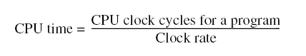
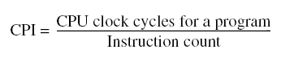
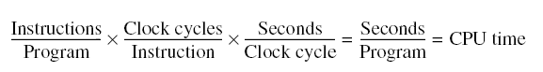
Principles of Computer Design
Principles
Equation for Processor Performance

Slide 49
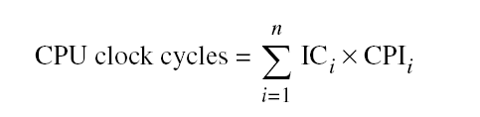
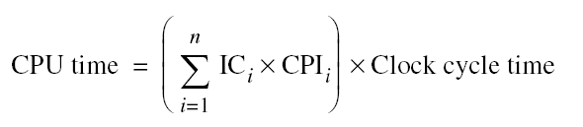
Principles of Computer Design
Principles
Different instruction types having different CPIs

Slide 50
Recall: Defining Computer Architecture
“Old” View of Computer Architecture:
Instruction set architecture (ISA) design
Decisions regarding
registers, memory addressing, addressing modes, instruction operands, available operations, control flow instructions, instruction encoding
“Real” Computer Architecture
Specific requirements of the target machine
Design to maximize performance within constraints: cost, power, and availability
Includes ISA, microarchitecture, hardware
Defining Computer Architecture
What about models for cost, power, and availability?

Slide 51
Classes of Computers
Classes of Computers
Personal Mobile Device (PMD)
Examples: Smartphones & tablet computers
Emphasis: Energy efficiency and real-time performance
Desktop Computing
Emphasis: Price-performance ratio
Servers
Emphasis: Availability, scalability, throughput
Clusters / Warehouse-Scale Computers
Used for “Software as a Service (SaaS)”
Emphasis: Availability and price-performance
Sub-class: Supercomputers
Emphasis: Floating-point performance and fast internal networks

Slide 52
Flynn’s Taxonomy (1966)
Classes of Computers
Classification of Computer Architectures
Single instruction stream, single data stream (SISD)
Single instruction stream, multiple data streams (SIMD)
Vector architectures
Multimedia extensions
Graphics processor units
Multiple instruction streams, single data stream (MISD)
No commercial implementation
Multiple instruction streams, multiple data streams (MIMD)
Tightly-coupled MIMD
Loosely-coupled MIMD

Slide 53
Additional Reading Assignments
Brian Hayes, “Computing in a Parallel Universe,” American Scientist, November-December 2007. https://www.americanscientist.org/article/computing-in-a-parallel-universe
Herb Sutter, “The Free Lunch Is Over: A Fundamental Turn Toward Concurrency in Software,” Dr. Dobb's Journal, 30(3), March 2005. http://gotw.ca/publications/concurrency-ddj.htm

